Slide 1
Statistical Data Mining Final project
Classifying fMRI Response of Face Image Change by Probabilistic Neural Network and Principle Component Method
Tzu-Ping Kao & Wei-Chun Chiang
06/30/2011

Slide 2
Outline
Problem Description
Data Description
Introduction to fMRI
Experimental Process
Main Experiment
Related Literature and Results
Analysis Procedure
What Parts Are New in this Project
Conclusion and Suggestion
Reference

Slide 3
Problem Description
In this class, we learning principle component analysis (PCA) method to extract characteristics of a data set.
This project will utilizes PCA to carry out feature reduction and Probabilistic Neural Networks to analyze the fMRI data. And then, predicting the experimental trials.

Slide 4
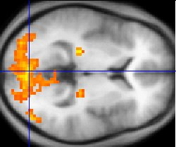
Introduction to fMRI
Functional magnetic resonance imaging(功能性核磁共振造影)
A type of specialized MRI scan used to measure the hemodynamic response (change in blood flow) related to neural activity in the brain or spinal cord of humans or other animals.
: complex moving visual stimulus
Notes:
功能性核磁共振造影(functional magnetic resonance imaging)，簡稱
fMRI，是以腦部神經活動產生的局部血流量變化為基礎的造影技術，藉此觀察
進行認知作業時活化的腦部區域。活化區域的血流量增加，超過了氧的消耗量，
使得血液中去氧血紅素(deoxyhemoglobin, dHb)的比例降低，由於去氧血紅素是
順磁性(paramagnetic)物質，會干擾局部磁場，去氧血紅素比例的減少，可使影
像強度增強，因此去氧血紅素有時被稱為內生性的對比增強劑(endogenous
contrast enhancing agent)，且是fMRI 訊號的來源，是為fMRI 技術的生理基礎

Slide 5
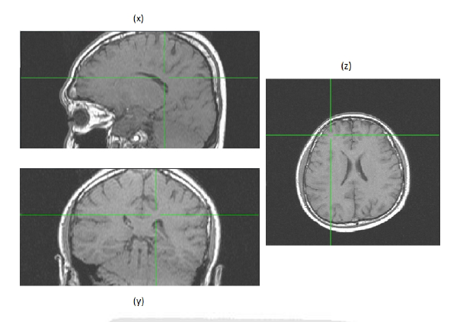
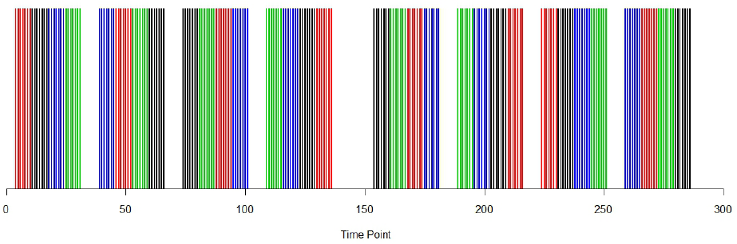
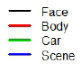
Experimental Process
This experiment contain three stages
Anatomical Stage
to acquire a high resolution brain image (10 minutes).
Localizer Stage
to find the location of FFA (Fusiform Face Area) by the contrast of the response of different stimulates.
Main Experiment
Run 1
Run 2
Notes:
在人腦中有一塊區域的細胞只對人的臉孔做反應，就是FFA
若是這個區域受損，會導致prosopagnosia 一種無法辨識臉孔的病，
患者無法認出自己熟悉的親友的臉孔，甚至是自己的臉孔

Slide 6
Main Experiment
Subjects encounter 4 different conditions
individual face, merge 3 faces, merge 6 faces, merge 10 faces
4 runs in this stage, 155 time points per run (2 second a time point), and 64 trials in a run.
If the two consecutive images were the same gender, click the left button. Otherwise click the right button.

Slide 7
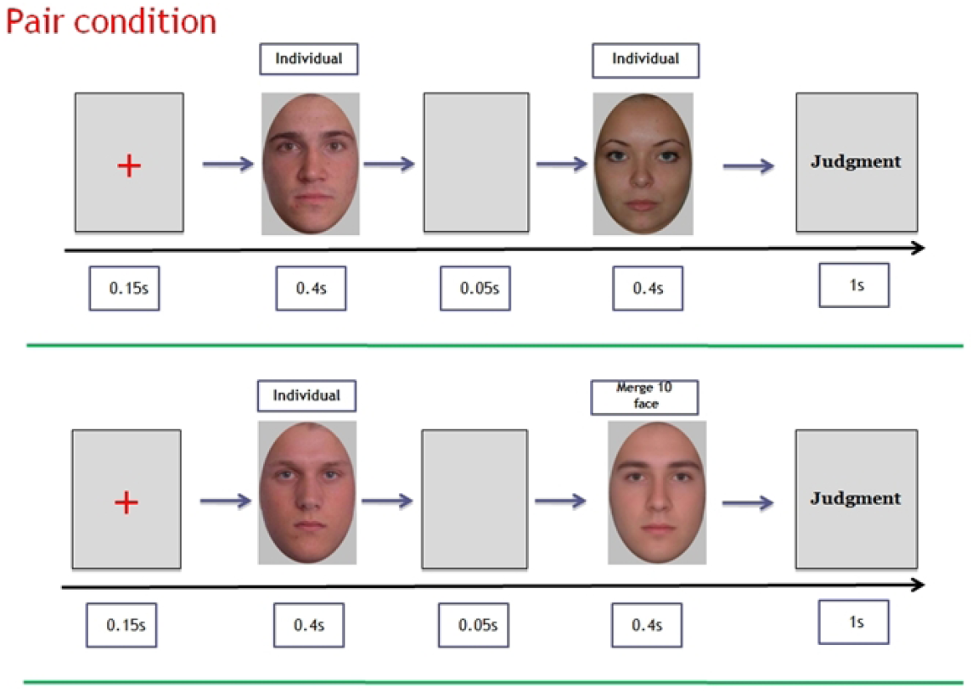
Main Experiment (cont’d)

Slide 8
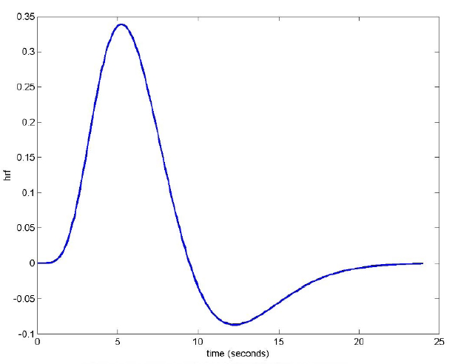
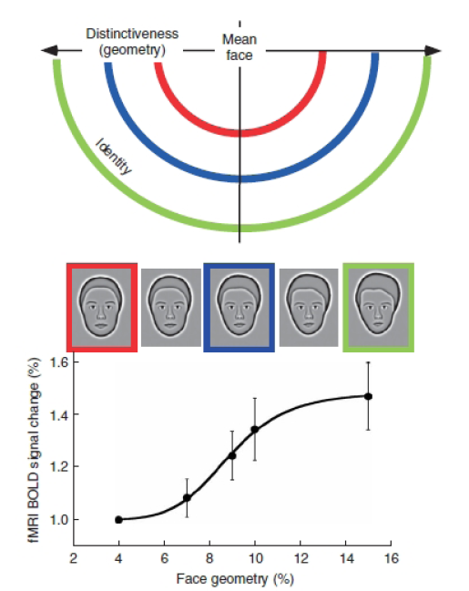
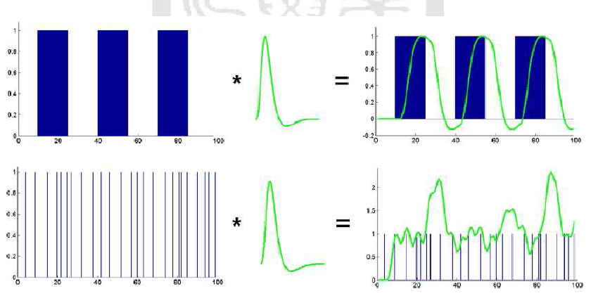
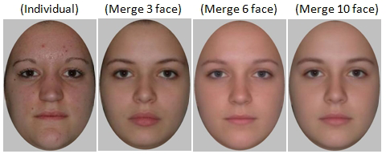
Data to analysis
: HRF
Notes:
the hemodynamic response function (HRF).
Functional magnetic resonance imaging is most commonly performed using blood oxygenation level dependent (BOLD)
contrast to study local changes in deoxyhemoglobin concentration in the brain. BOLD
imaging takes advantage of inherent differences between oxygenated and deoxygenated
hemoglobin.

Slide 9
Research topic
The literature's idea:
We are interested in whether the evoked BOLD responses by individual face are larger than evoked responses by merged face.
Our idea:
We are interested in whether we can construct a classifier to discriminant the type of the experimental trials by using the evoked BOLD responses.
Analysis methods includes: Feature extraction, Feature reduction, machine learning based Classifier.
Target: To achieve a satisfactory recognition rate.

Slide 10
Analysis Flow
Data Preprocessing
Feature Extraction
Feature Reduction
Classifier

Slide 11
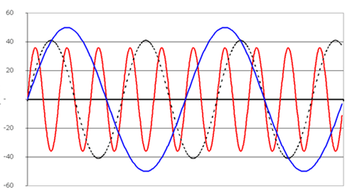
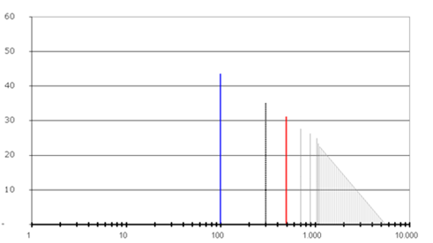
Filter Concept
: 若一個訊號是由三種不同頻率
震動的弦波所組合而成，圖中
分別假設為100Hz(藍色)，300Hz
(黑色)，500Hz(紅色)，則在頻域
的分析上，即可看出在該頻率上
震幅的大小，由下圖中可對照看
出，100Hz(藍色)的頻率下，有最
大振福。

Slide 12
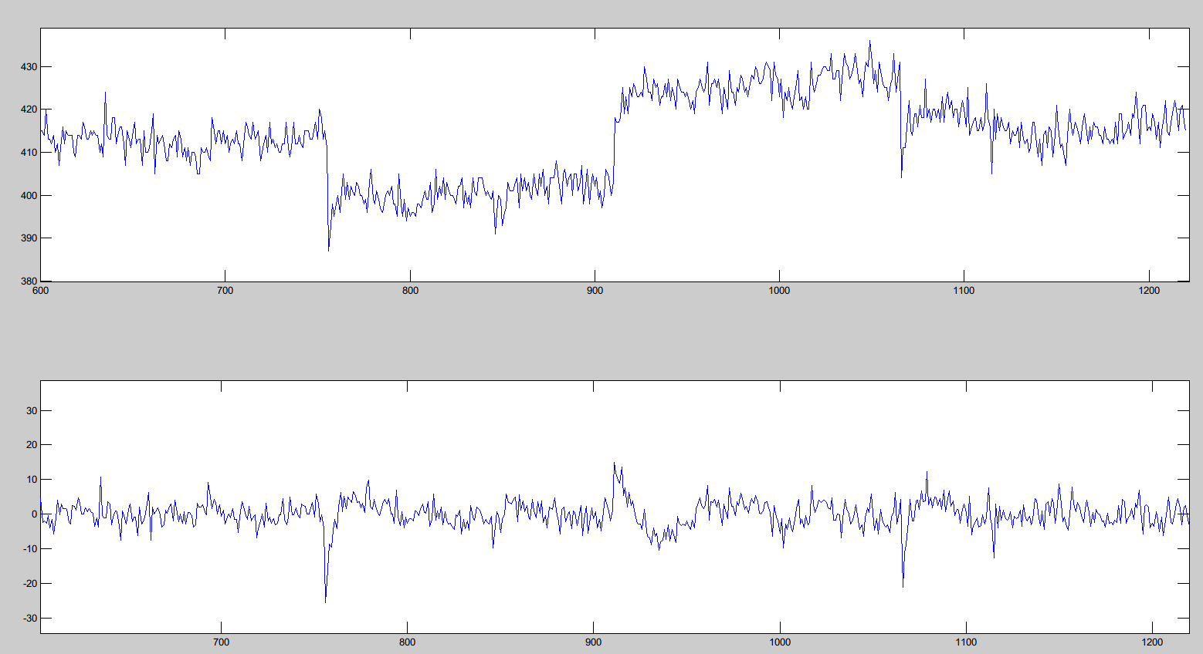
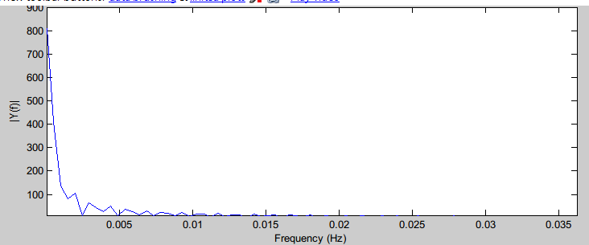
Data Preprocessing to the #14
0.005Hz
: 由頻域分析看出，該訊號有一個很大的Bias及低頻雜訊

Slide 13
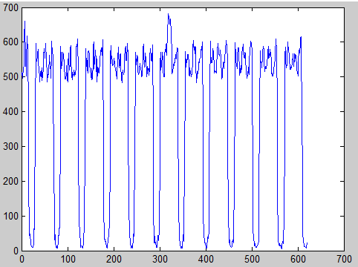
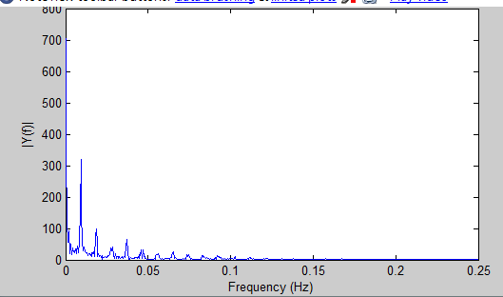
Data Preprocessing to the #15
第十五號受試者解碼出的原始訊號會如圖出現週期性的變化，無法正確濾波

Slide 14
Data Preprocessing Result of #14
Before filter
After filter

Slide 15
Feature Extraction
Raw data dimension: 54*64*30*620
We extract from:
X: 20~37
Y: 15~40
Z: 10~25
Total dimension: 18*26*16=7488
Each dimension has 620 time points
Ground_truth: Each pair condition
Ind-ind: 64 samples
Ind-3mer: 64 samples
Ind-6mer: 64 samples
Ind-10mer: 64 samples

Slide 16
Feature Reduction
Reduce dimension of the features to 19 for #14
Classification Rate
Dimension

Slide 17
Feature Reduction (cont’d)
Reduce dimension of the features to 36 for #15
Classification Rate
Dimension

Slide 18
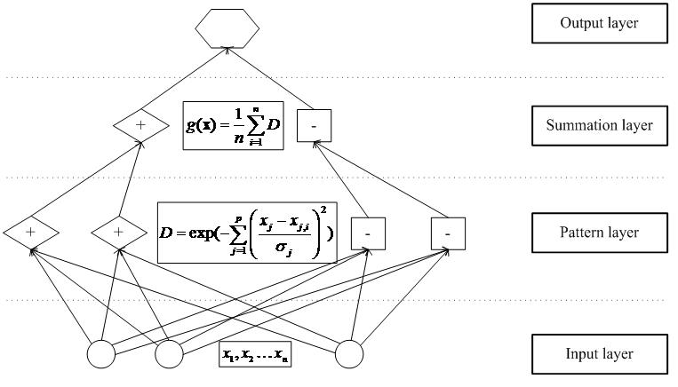
Classifier (PNN)
Architecture of Probabilistic neural network
Output: Four classified trials

Slide 19
Trial Results (#14)
Traing Data: 50 from each group. Test Data: 14 from each group
The classification result of PCA+PNN without filtering
 | ind | 3mer | 6mer | 10mer
ind | 14 | 14 | 14 | 14
3mer | 0 | 0 | 0 | 0
6mer | 0 | 0 | 0 | 0
10mer | 0 | 0 | 0 | 0
由左表得知本方法所的到之辨識率(辨識率＝6)優於隨機猜測之結果(辨識率＝3.5)
The classification result of PCA+PNN with filtering
 | ind | 3mer | 6mer | 10mer
ind | 5 | 5 | 5 | 2
3mer | 4 | 5 | 2 | 3
6mer | 1 | 2 | 6 | 1
10mer | 4 | 2 | 1 | 8

Slide 20
Trial Results (#15)
Traing Data: 50 from each group. Test Data: 14 from each group
Without filtering
 | ind | 3mer | 6mer | 10mer
ind | 14 | 14 | 14 | 14
3mer | 0 | 0 | 0 | 0
6mer | 0 | 0 | 0 | 0
10mer | 0 | 0 | 0 | 0
由左表得知本方法所的到之辨識率(辨識率＝5.5)優於隨機猜測之結果(辨識率＝3.5)
Filtering
 | ind | 3mer | 6mer | 10mer
ind | 4 | 3 | 4 | 1
3mer | 3 | 6 | 5 | 3
6mer | 3 | 2 | 5 | 4
10mer | 4 | 3 | 0 | 6

Slide 21
What Parts Are New in this Project
In this project, we combine filtering method to preprocess raw data and utilize principle component analysis method to accomplish feature reduction.
Finally, applying a probabilistic neural network method to classify the BOLD responses.
In our testing, this method can achieve a satisfactory recognition rate.

Slide 22
Conclusion and Future Work
The data will have a better classification result via filter preprocessing.
But the feature dimension has a limited influence on the classification.
In our trial results, we utilize try-and-error policy to decide the feature dimension. Therefore, if we can develop a auto-decision method to decide the dimension of feature, this classification algorithm will be perfect.

Slide 23
Reference
M. H. Chen, “Spatial Testing and Spatial Clustering with Application to Wafer Bin Map and Functional MRI Data,” M.S. Thesis, Department of Statistics, National Cheng Kung Univ., Tainan, Taiwan, 2010.
K. Z. Mao, K. C. Tan, and W. Ser, “Probabilistic Neural-Network Structure Determination for Pattern Classification,” IEEE Trans. Neural Networks, vol. 11, pp. 1009-1016, 2000.
A. V. Oppenheim, R. W. Schafer, and J. R. Buck, Discrete-Time Signal Processing. Prentice Hall, 1999.

